Slide 1

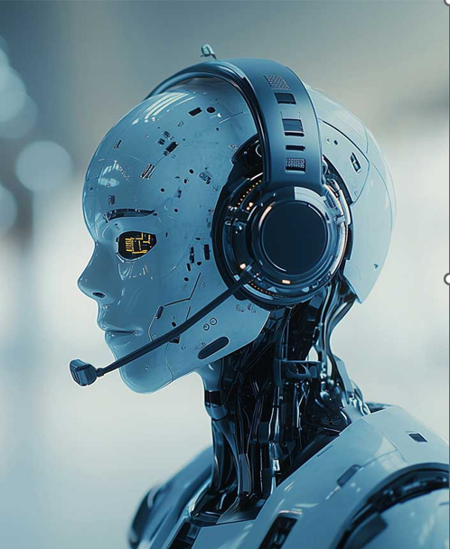
USN | NAME
2SD22CS130 | POOJA S DODDAGOUDAR
2SD23CS400 | AMBIKA T CHAVAN
2SD23CS407 | PUNARVASU SHETAKE
2SD23CS409 | SMITAL S KAGINKAR

Slide 2
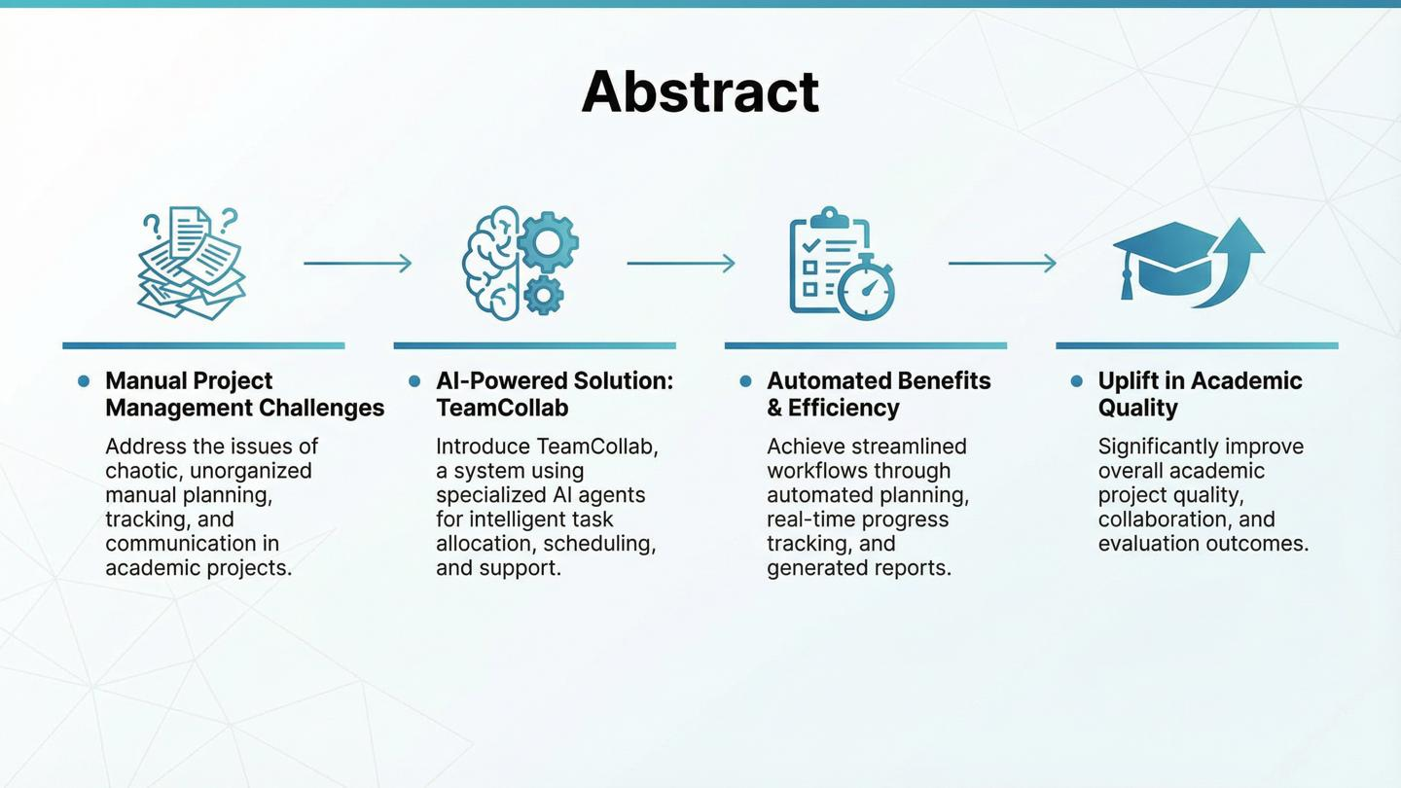

Slide 3
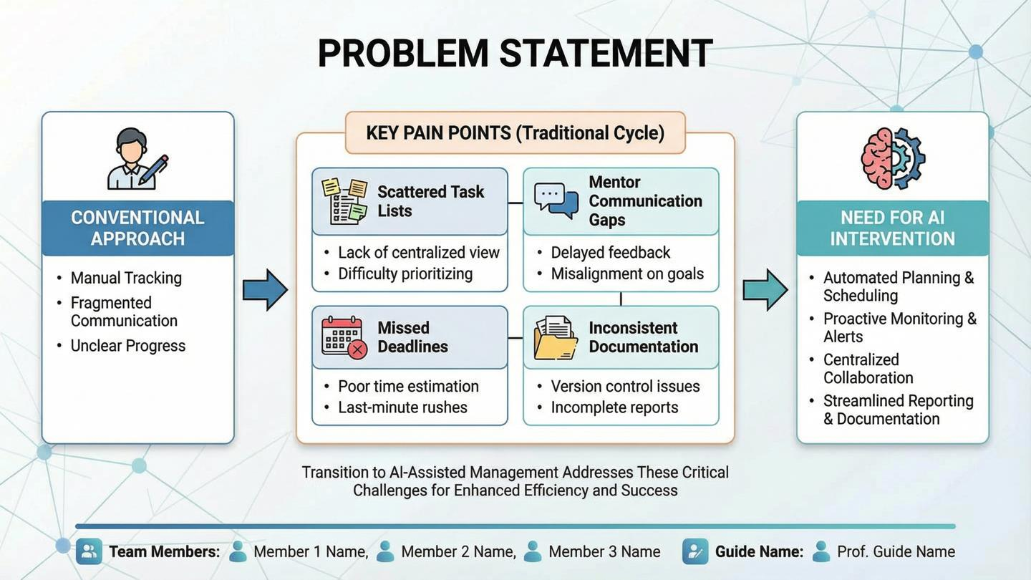

Slide 4
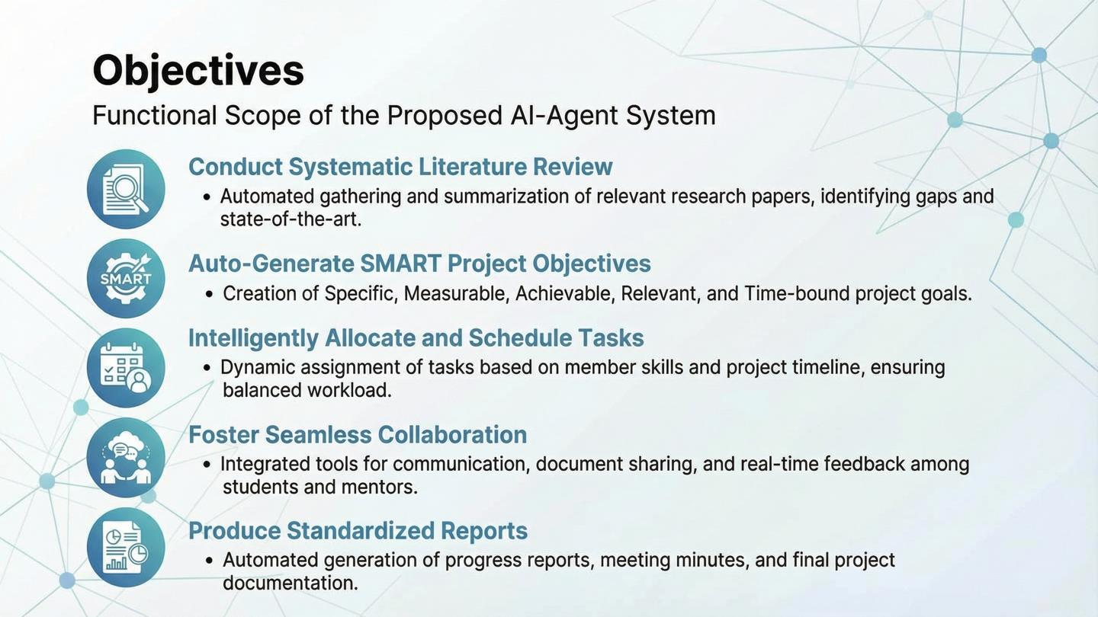

Slide 5
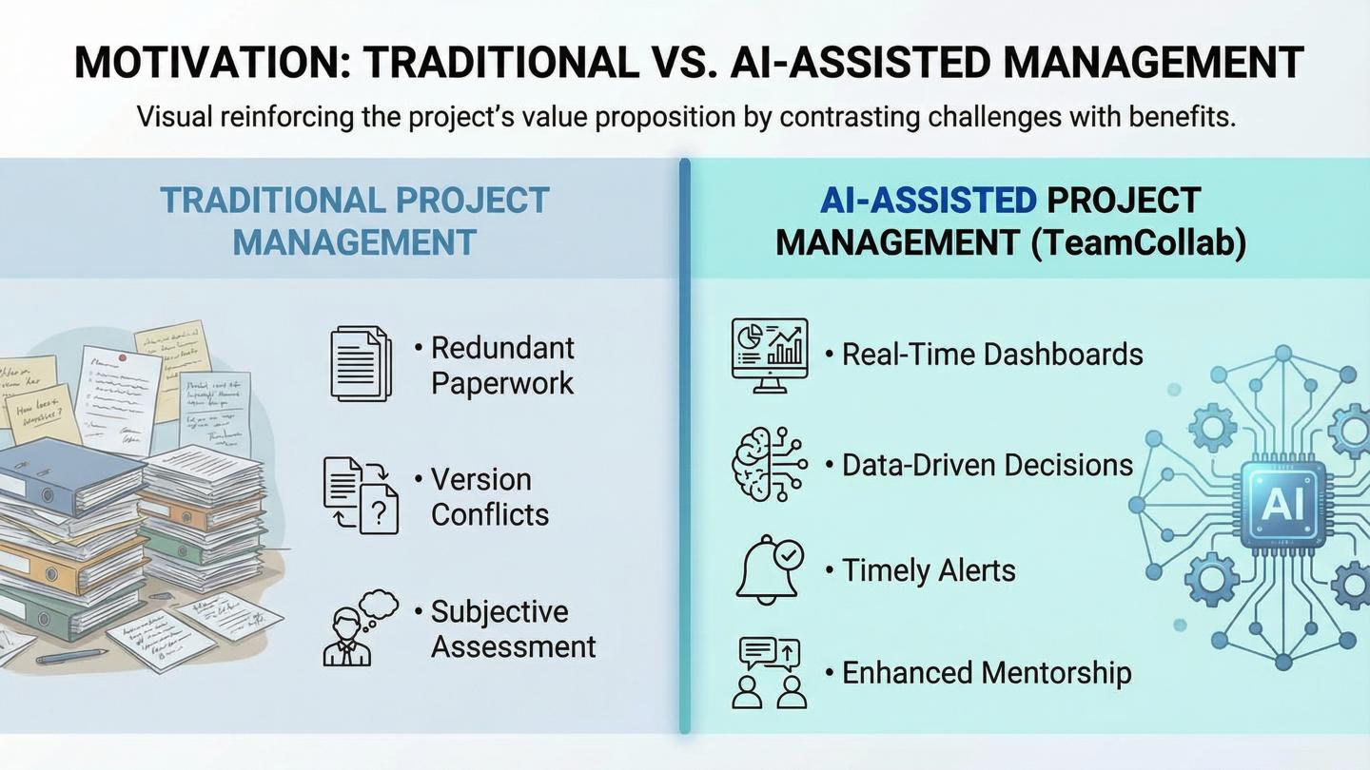

Slide 6
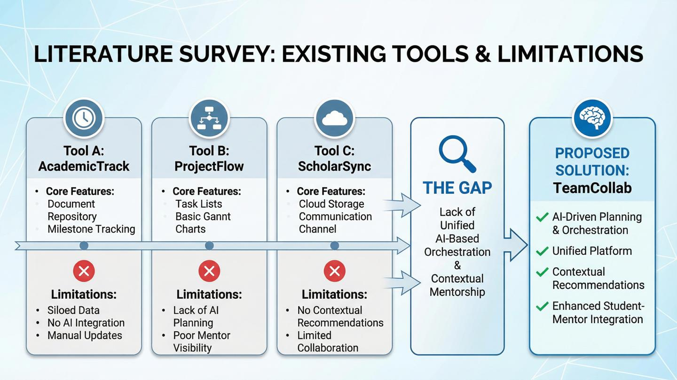

Slide 7
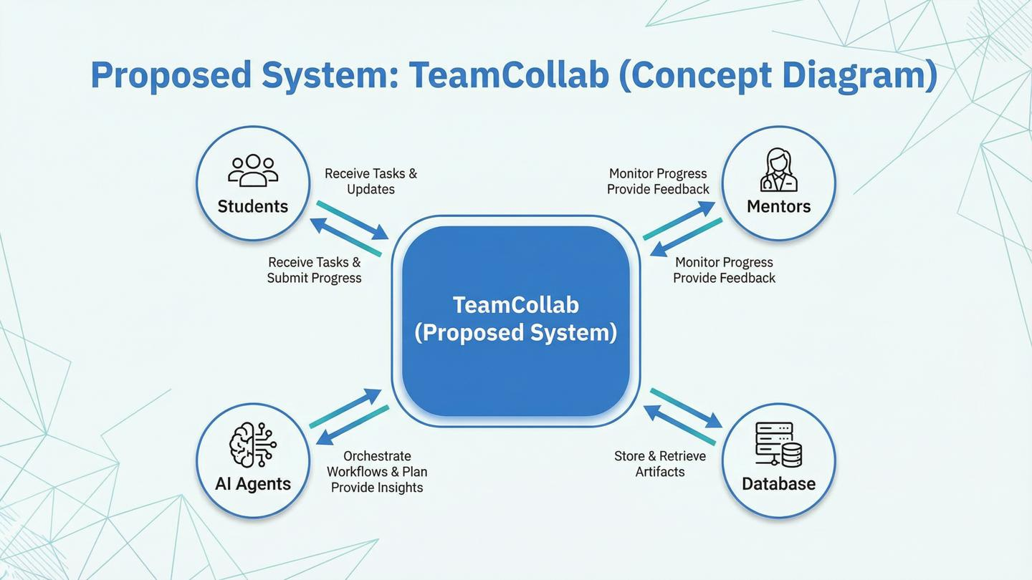

Slide 8
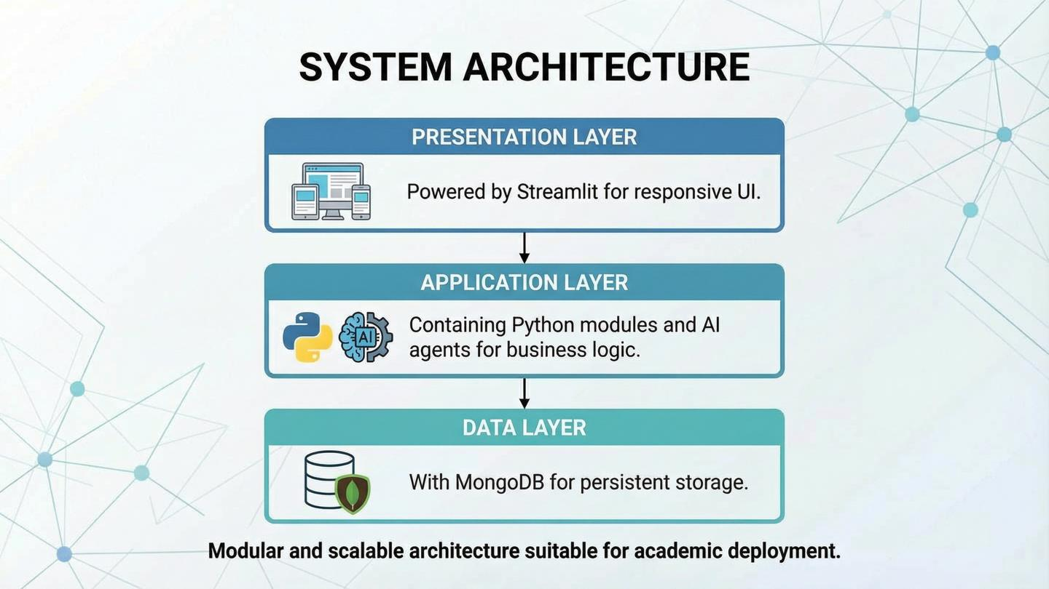
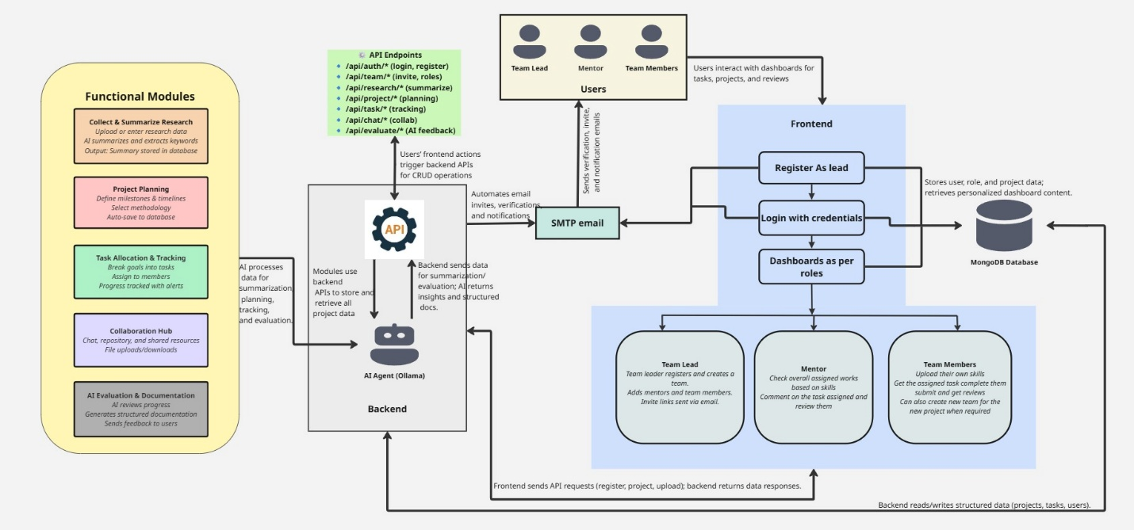

Slide 9
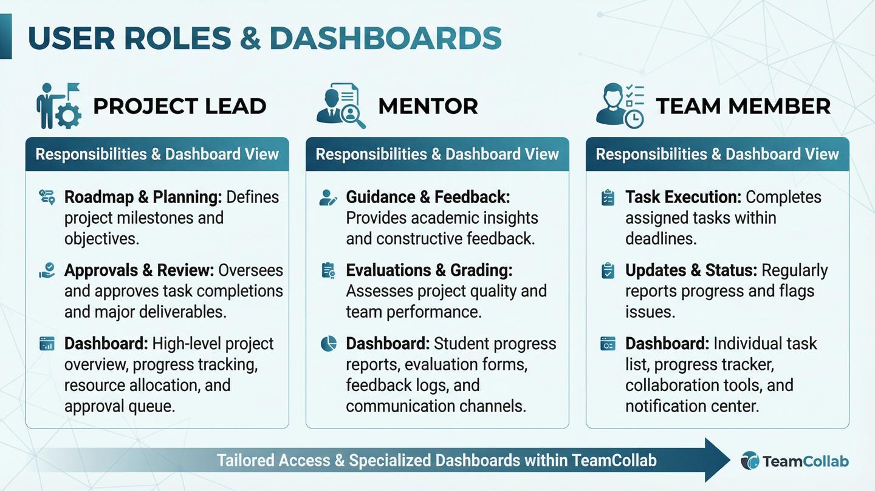


Slide 10
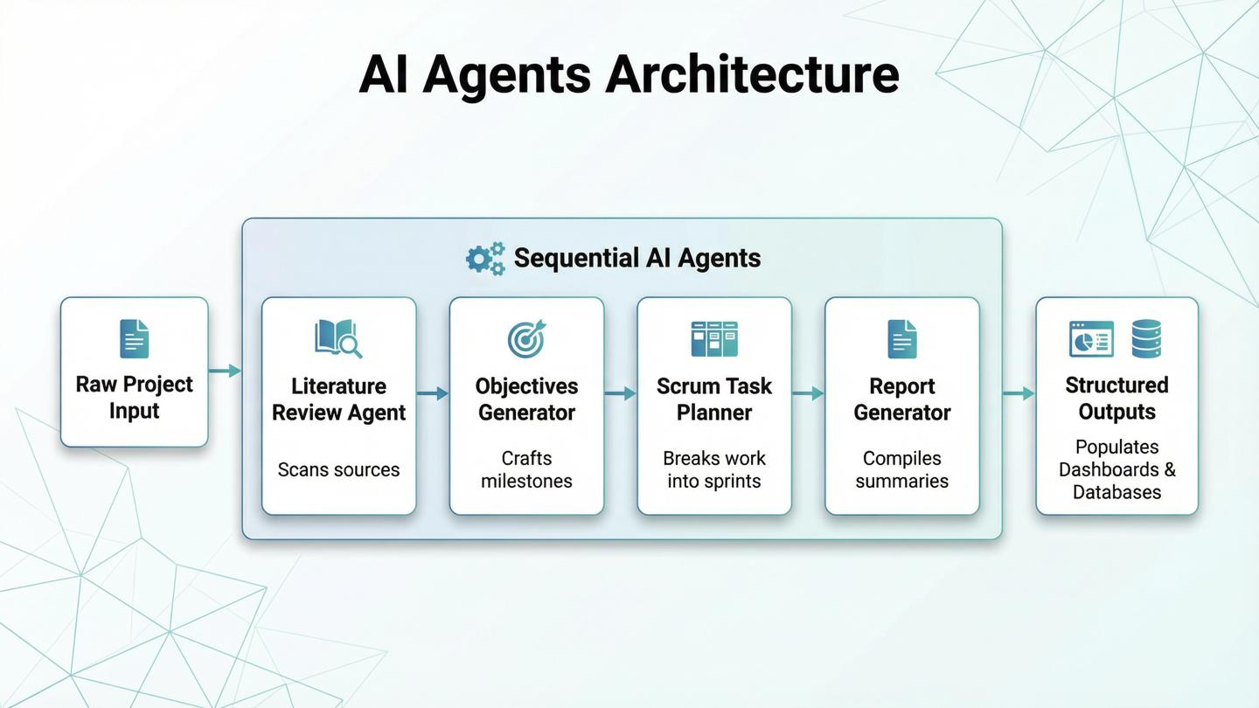

Project Flow

Slide 11
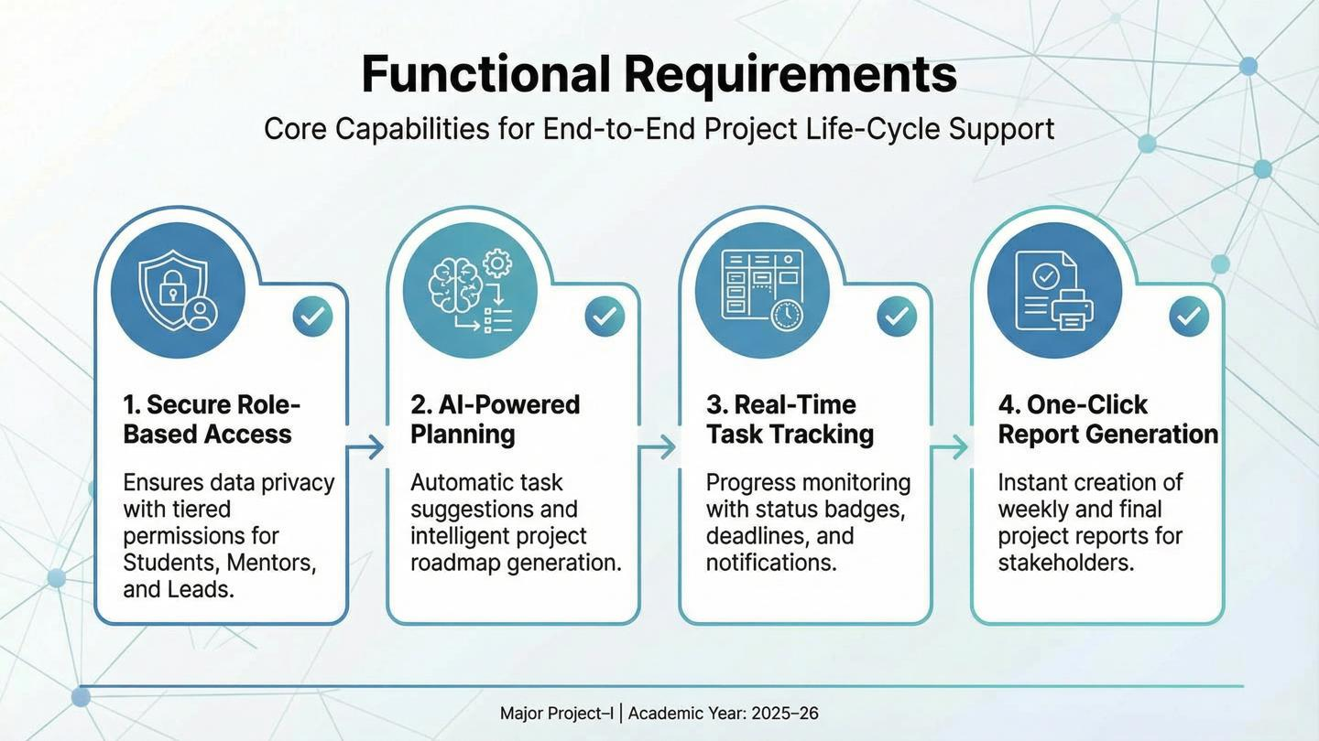

Slide 12
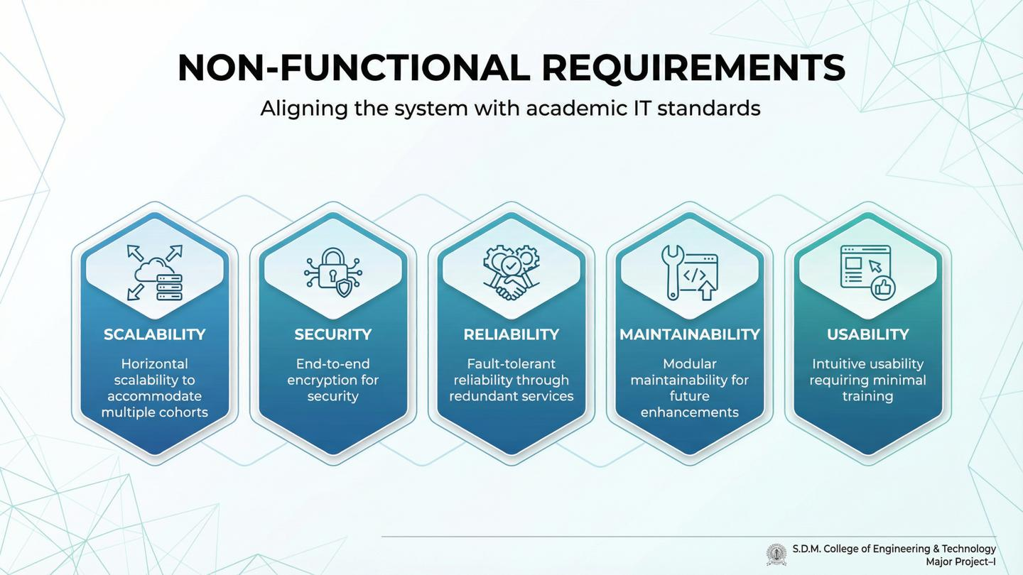

Slide 13
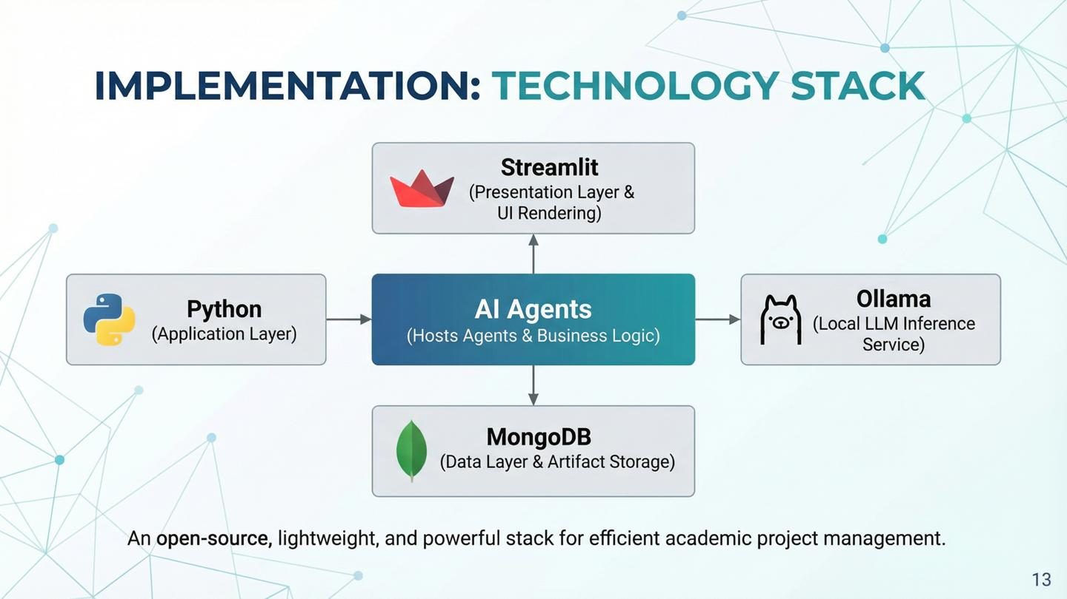

Slide 14
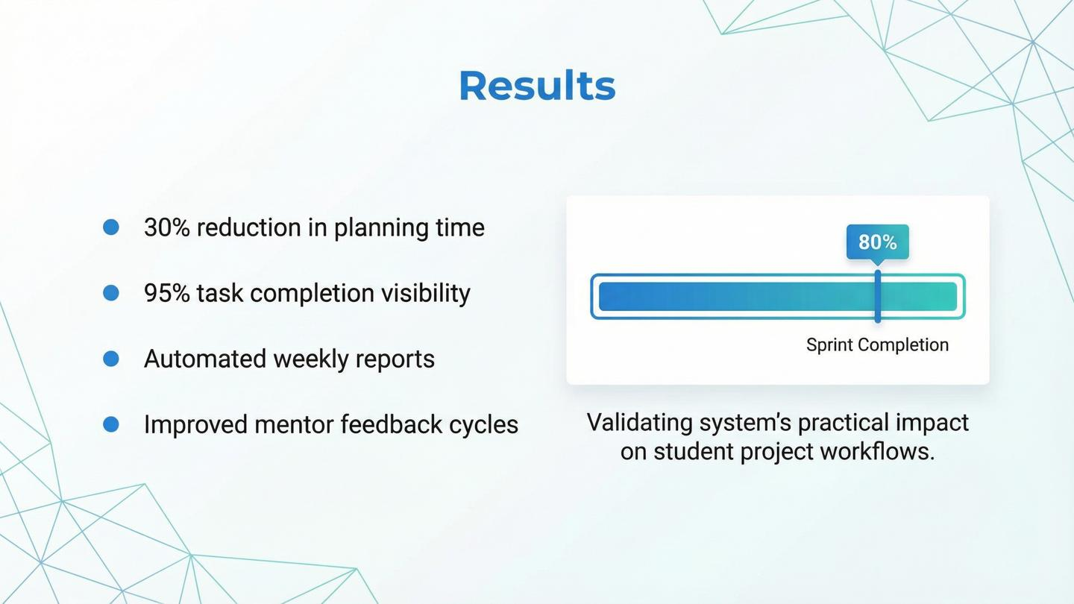

Jira Vs Team Collab
Aspect | Jira | Team Collab
Purpose | Industry software project management | Academic project management
Target Users | Developers, managers, enterprise teams | Students, Project Leads, Mentors
AI Integration | Basic rule-based automation | Intelligent AI agents
Academic Support | No research or academic planning | AI-assisted literature & objectives
Mentor Involvement | Managerial tracking | Mentor supervision & evaluation
Task Planning | Scrum / Kanban for delivery | Scrum adapted for academics
Documentation | Manual, external tools | Automated IEEE-style reports
Privacy & Usability | Cloud-based, online only | Local AI, private & offline

Slide 15
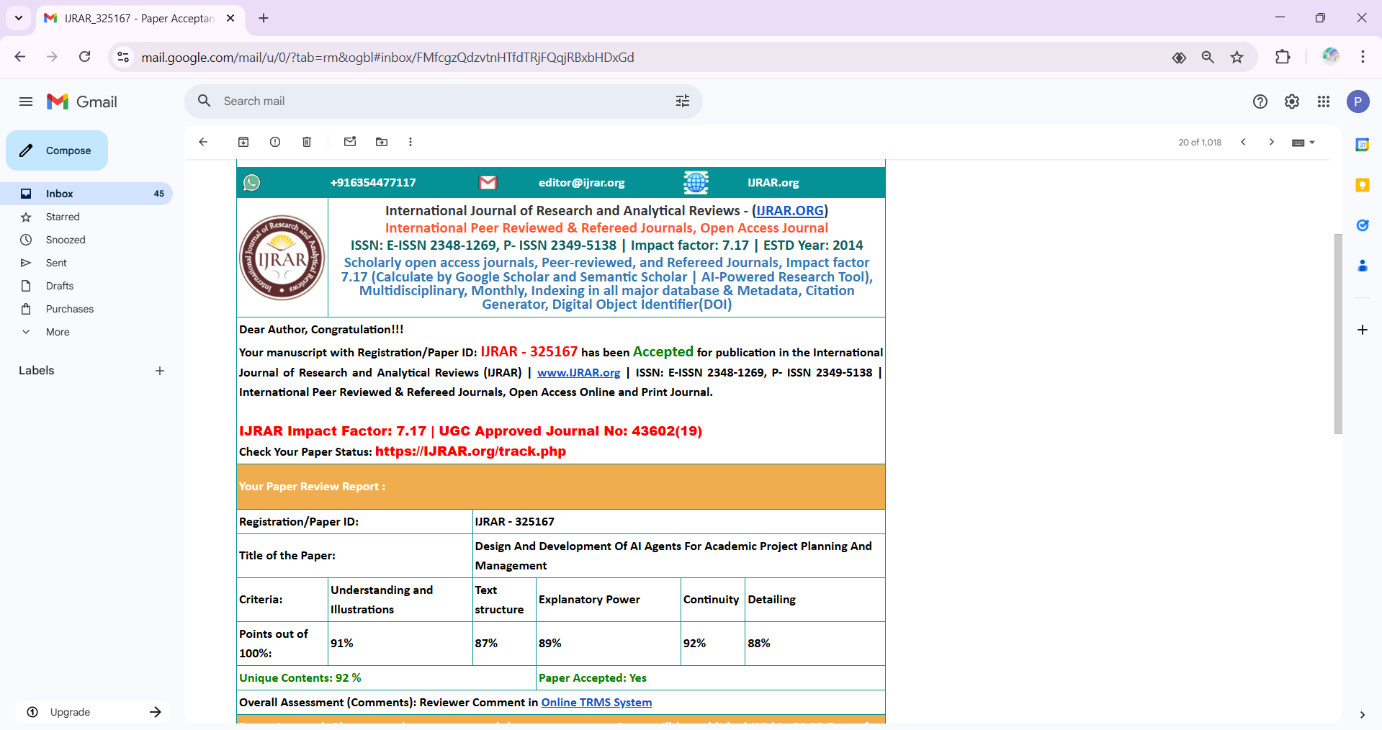

Slide 16
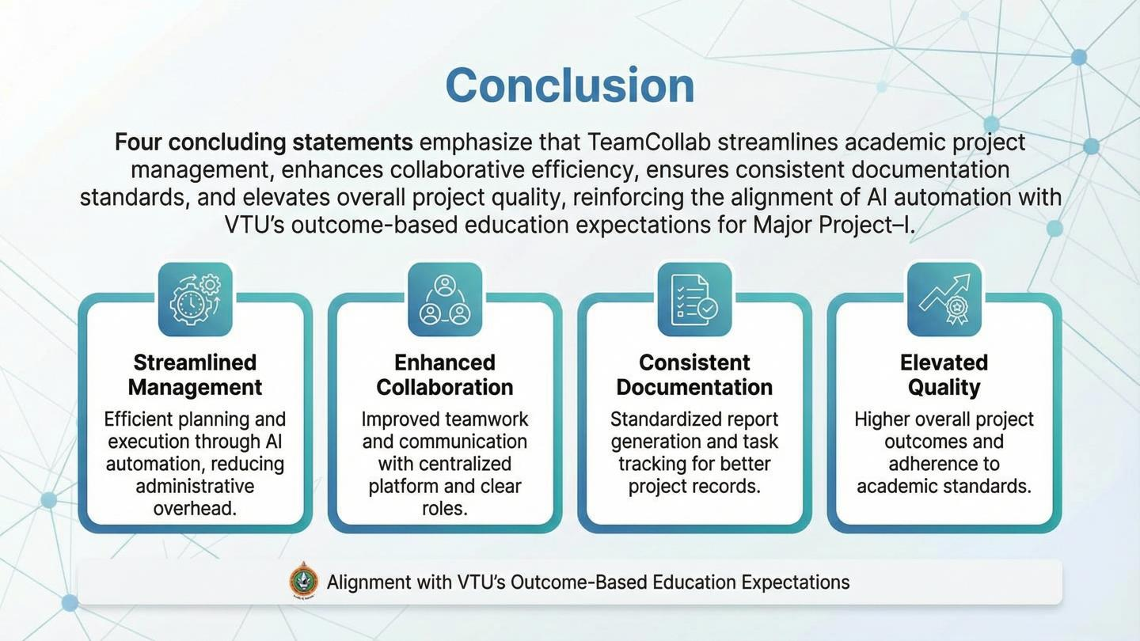



Slide 17
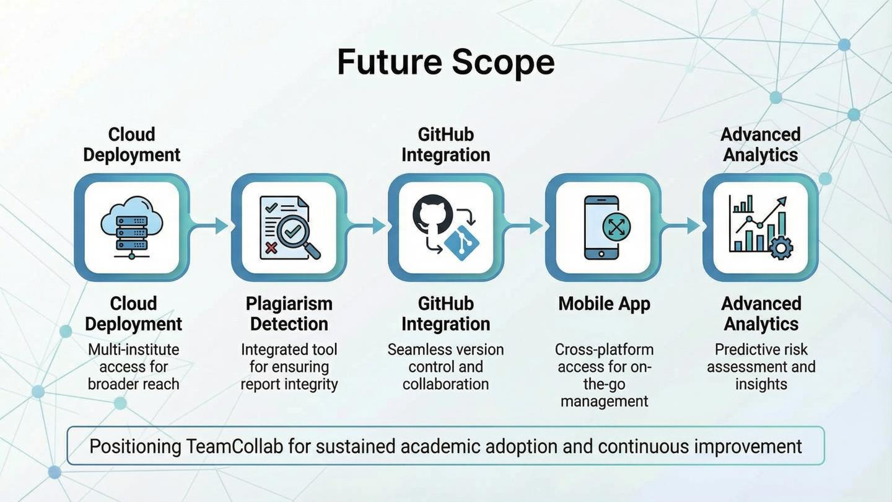



Slide 18

Thank You
THANK YOU
Questions & Discussion
Department ofComputer Science & Engineering,S.D.M.College of Engineering & Technology,Dharwad
MajorProject-I|2025-26

